Slide 1
Data Science Final Project
Anupama Indeewari Basnayaka

Slide 2

Contents
Executive Summary
Introduction
Methodology
Results
Conclusion
Appendix

Slide 3

Executive Summary
Summary of methodologies
  Data collection
  Data wrangling
  Exploratory Data Analysis with Data Visualization
  Exploratory Data Analysis with SQL
  Building an interactive map with Folium
  Building a Dashboard with Plotly Dash
  Predictive analysis (Classification)
Summary of all results :
  Exploratory Data Analysis results
  Interactive analytics demo in screenshots
  Predictive analysis results

Slide 4

Introduction
Project Background:
SpaceX stands out as a frontrunner in the commercial space industry, revolutionizing space travel and making it more accessible. With its Falcon 9 rocket launches priced at 62 million dollars, significantly lower than competitors' costs of up to 165 million dollars per launch, SpaceX's ability to reuse the first stage plays a pivotal role in cost reduction. Hence, predicting the success of the first stage landing becomes crucial in determining the overall cost-effectiveness of a launch.
Key Questions:
  How do variables such as payload mass, launch site, number of flights, and orbits influence the success of the first stage landing?
  Is there a noticeable trend in the rate of successful landings over the years?
  Which machine learning algorithm yields the most accurate binary classification for predicting the success of the first stage landing?
In addressing these questions, we aim to gain deeper insights into the factors influencing the success of SpaceX's first stage landings and identify the most effective approach for predicting these outcomes.

Slide 5
Methodology
Exploratory Data Analysis (EDA):
  Utilized visualization and SQL
  Uncovered insights and patterns
Interactive Visual Analytics:
  Leveraged Folium and Plotly Dash
  Enhanced understanding through dynamic visualizations
Predictive Analysis:
  Built, tuned, and evaluated classification models
  Ensured optimal performance and accuracy
Data Collection Methodology:
  Utilized SpaceX Rest API
  Employed Web Scraping from Wikipedia
Data Wrangling Process:
  Filtered data
  Handled missing values
  Used One Hot Encoding for binary classification

Slide 6
METHODOLOGY

Slide 7
Data Collection
Our data collection process involved a dual approach, utilizing both SpaceX's REST API and web scraping from a table within SpaceX's Wikipedia entry. This combined methodology was essential to gather comprehensive information about the launches, facilitating a more thorough analysis.
Data Columns Obtained via SpaceX REST API:
  FlightNumber
  Date
  BoosterVersion
  PayloadMass
  Orbit
  LaunchSite
  Outcome
  Flights
  GridFins
  Reused
Data Columns Obtained via Wikipedia Web Scraping:
Flight No.
Launch Site
Payload
PayloadMass
Orbit
Customer
Launch Outcome
Version Booster
Booster Landing
Date
Time
Legs
LandingPad
Block
ReusedCount
Serial
Longitude
Latitude

Slide 8
Data Collection – SpaceXP API
Retrieving rocket launch data from the SpaceX API.
Decoding the response content using .json() and turning it into a dataframe using
.json_normalize()
Requesting needed information about the launches from SpaceX API
by applying custom functions
Constructing data we have obtained into a dictionary
Exporting the data to CSV
Replacing missing values of Payload Mass column with calculated .mean() for this column
Filtering the dataframe to only include Falcon 9 launches
Creating a dataframe from the dictionary

Slide 9
Data Collection- Wrangling
Requesting Falcon 9 launch data from Wikipedia
Creating a BeautifulSoup object from the HTML response
Extracting
all column names
from the HTML table header
Collecting the
data by parsing
HTML tables
Exporting the
data to CSV
Creating a
dataframe from
the dictionary
Constructing data we have obtained into a dictionary

Slide 10
Data Wrangling
In the dataset, various scenarios depict unsuccessful booster landings. This includes instances where a landing was attempted but failed due to accidents. For instance:
"True Ocean" indicates a successful landing in a specific region of the ocean.
"False Ocean" indicates an unsuccessful landing in a specific region of the ocean.
"True RTLS" indicates a successful landing on a ground pad.
"False RTLS" indicates an unsuccessful landing on a ground pad.
"True ASDS" indicates a successful landing on a drone ship.
"False ASDS" indicates an unsuccessful landing on a drone ship.
To simplify these outcomes into training labels:
"1" represents a successful booster landing.
"0" represents an unsuccessful booster landing.
Perform exploratory Data Analysis and determine Training Labels
Calculate the number of launches on each site.
Calculate the number and occurrence of each orbit.
Calculate the number and occurrence of mission outcome per orbit type.
Create a landing outcome label from Outcome column.
Exporting the data to CSV.

Slide 11
EDA with Data Visualization
Charts were plotted:
Flight Number vs. Payload Mass, Flight Number vs. Launch Site, Payload Mass vs. Launch Site, Orbit Type vs. Success Rate, Flight Number vs. Orbit Type, Payload Mass vs Orbit Type and Success Rate Yearly Trend.
Scatter plots show the relationship between variables. If a relationship exists, they could be used in machine learning model.
Bar charts show comparisons among discrete categories. The goal is to show the relationship between the specific categories being compared and a measured value.
Line charts show trends in data over time (time series).

Slide 12
EDA with SQL
Performed SQL queries:
Displaying the names of the unique launch sites in the space mission
Displaying 5 records where launch sites begin with the string ‘CCA'
Displaying the total payload mass carried by boosters launched by NASA (CRS)
Displaying average payload mass carried by booster version F9 v1.1
Listing the date when the first successful landing outcome in ground pad was achieved
Listing the names of the boosters which have success in drone ship and have payload mass greater than 4000 but less than 6000
Listing the total number of successful and failure mission outcomes
Listing the names of the booster versions which have carried the maximum payload mass
Listing the failed landing outcomes in drone ship, their booster versions and launch site names for the months in year 2015
Ranking the count of landing outcomes (such as Failure (drone ship) or Success (ground pad)) between the date 2010-06-04 and 2017-03-20 in descending order

Slide 13
Build an interactive Map with Folium
Markers of all Launch Sites:
Added Marker with Circle, Popup Label and Text Label of NASA Johnson Space Center using its latitude and longitude coordinates as a start location.
Added Markers with Circle, Popup Label and Text Label of all Launch Sites using their latitude and longitude coordinates to show their geographical locations and proximity to Equator and coasts.
Coloured Markers of the launch outcomes for each Launch Site:
Added coloured Markers of success (Green) and failed (Red) launches using Marker Cluster to identify which launch sites have relatively high success rates.
Distances between a Launch Site to its proximities:
Added coloured Lines to show distances between the Launch Site KSC LC-39A (as an example) and its proximities like Railway, Highway, Coastline and Closest City.

Slide 14
Build a Dashboard with Plotly Dish
Launch Sites DropDown List:
  Added a dropdown list to enable Launch Site selection.
Pie Chart showing Success Launches (All Sites/Certain Site):
  Added a pie chart to show the total successful launches count for all sites and the Success vs. Failed counts for the site, if a specific Launch Site was selected.
Slider of Payload Mass Range:
  Added a slider to select Payload range.
Scatter Chart of Payload Mass vs. Success Rate for the different Booster Versions:
  Added a scatter chart to show the correlation between Payload and Launch Success.

Slide 15
Predictive Data Analysis (Classification)
Creating a NumPy array from the column “Class” in data
Standardizing the data with StandardScaler, then fitting and transforming it.
Splitting the data into training and testing sets with train_test_split function
Creating a GridSearchCV object with cv = 10 to find the best parameters
Finding the method performs best by examining the Jaccard_score and F1_score metrics
Examining the confusion matrix for all models
Calculating the accuracy on the test data using the method .score()
for all models
Applying GridSearchCV on LogReg, SVM,Decision Tree, and KNN models

Slide 16

Results
Exploratory Data Analysis.
Interactive analytics demo in screenshots.
Predictive analysis

Slide 17
EDA with Visualization

Slide 18
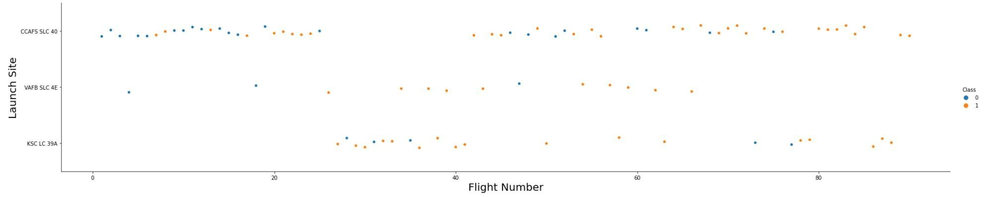
Flight Number vs. Launch Site
Explanation:
The earliest flights all failed while the latest flights all succeeded.
The CCAFS SLC 40 launch site has about a half of all launches.
VAFB SLC 4E and KSC LC 39A have higher success rates.
It can be assumed that each new launch has a higher rate of success

Slide 19
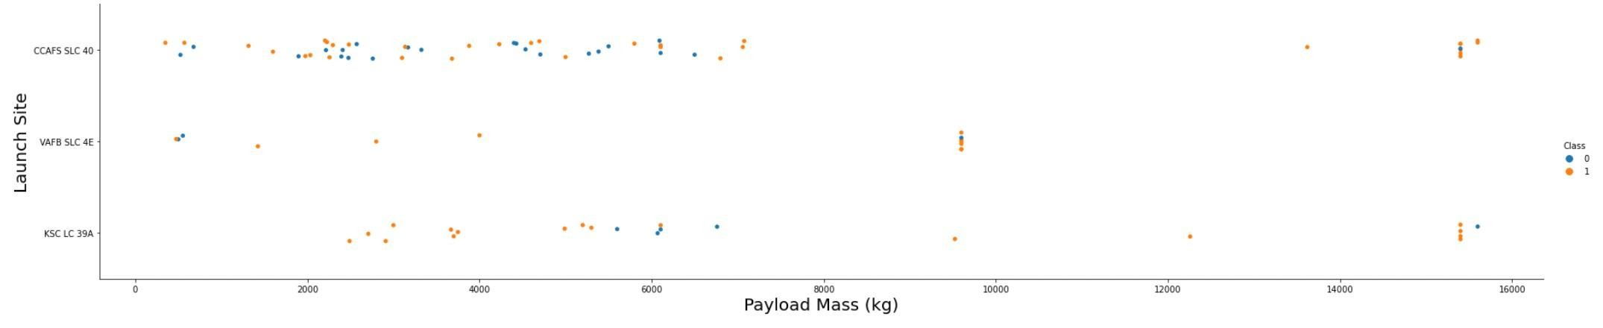
Playload vs. Launch Site
Explanation:
The data analysis reveals a notable correlation between payload mass and launch success rate across various launch sites. Specifically, launches with higher payload masses tend to exhibit higher success rates. Additionally, it's evident that the majority of launches with payload masses exceeding 7000 kg have been successful.
Interestingly, KSC LC 39A stands out with a remarkable 100% success rate for payloads weighing under 5500 kg. This indicates that the launch site's performance is particularly reliable for handling payloads within this weight range.

Slide 20
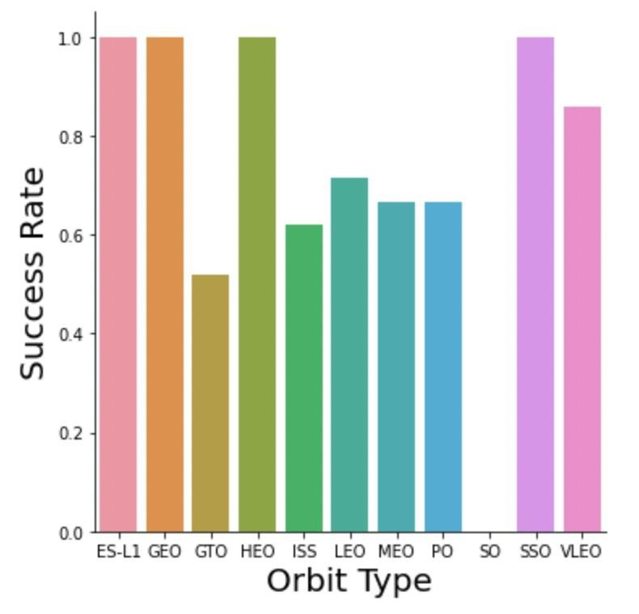
Success rate vs. Orbit type
Explanation:
Orbits with a 100% success rate include ES-L1, GEO, HEO, and SSO. These orbits have consistently yielded successful missions.
Conversely, the orbit with a 0% success rate is SO. This orbit has experienced no successful missions based on the available data.
Orbits with success rates falling between 50% and 85% encompass GTO, ISS, LEO, MEO, and PO. These orbits have demonstrated varying degrees of success, indicating a moderate to high level of reliability in achieving mission objectives.

Slide 21
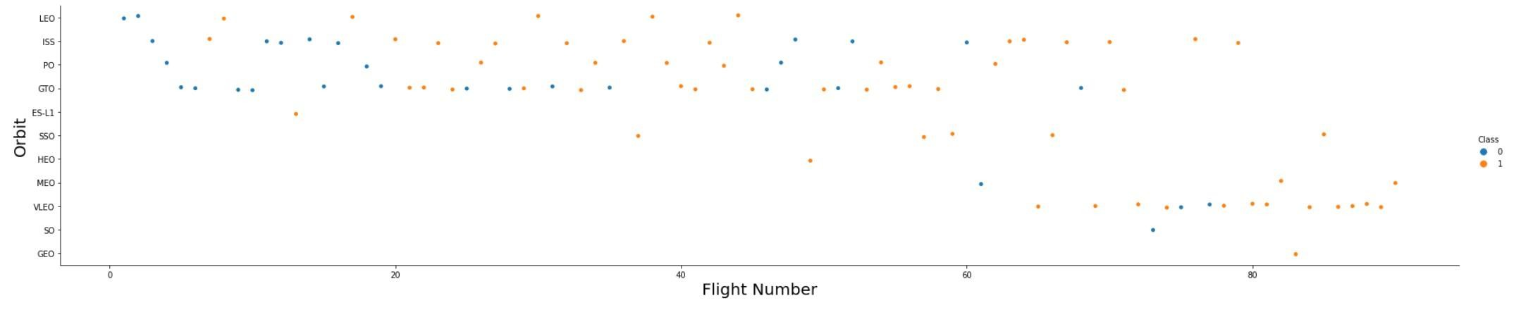
Flight Number vs.Orbit type
Explanation:
In the Low Earth Orbit (LEO), the success rate appears to be correlated with the number of flights. As the number of flights increases, so does the success rate, suggesting a positive relationship between the two variables.
However, in the Geostationary Transfer Orbit (GTO), there seems to be no discernible relationship between the flight number and the success rate. Regardless of the number of flights, the success rate remains inconsistent, indicating that other factors may influence mission outcomes in this orbit.

Slide 22
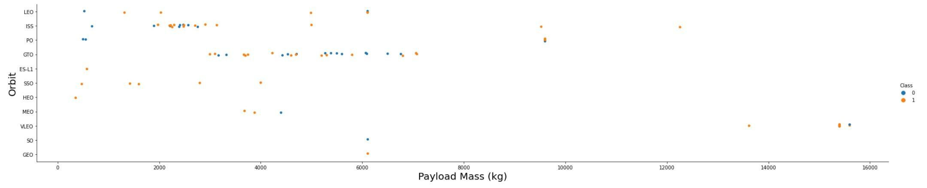
Playload Mass vs. Orbit type
Explanation:
In Geostationary Transfer Orbit (GTO), heavy payloads have a negative influence on the success rate. Conversely, in Geostationary Earth Orbit (GEO) and Polar Low Earth Orbit (ISS), heavy payloads have a positive impact on the success rate.

Slide 23
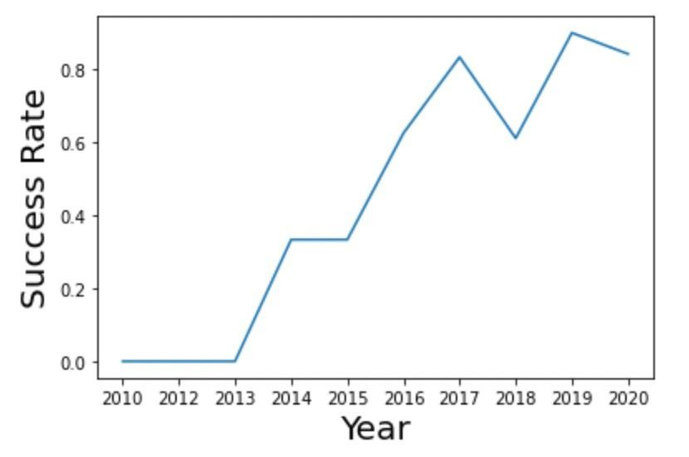
Launch success yearly trend
Explanation:
The success rate has been steadily increasing since 2013 until 2020.

Slide 24
EDA with SQL

Slide 25
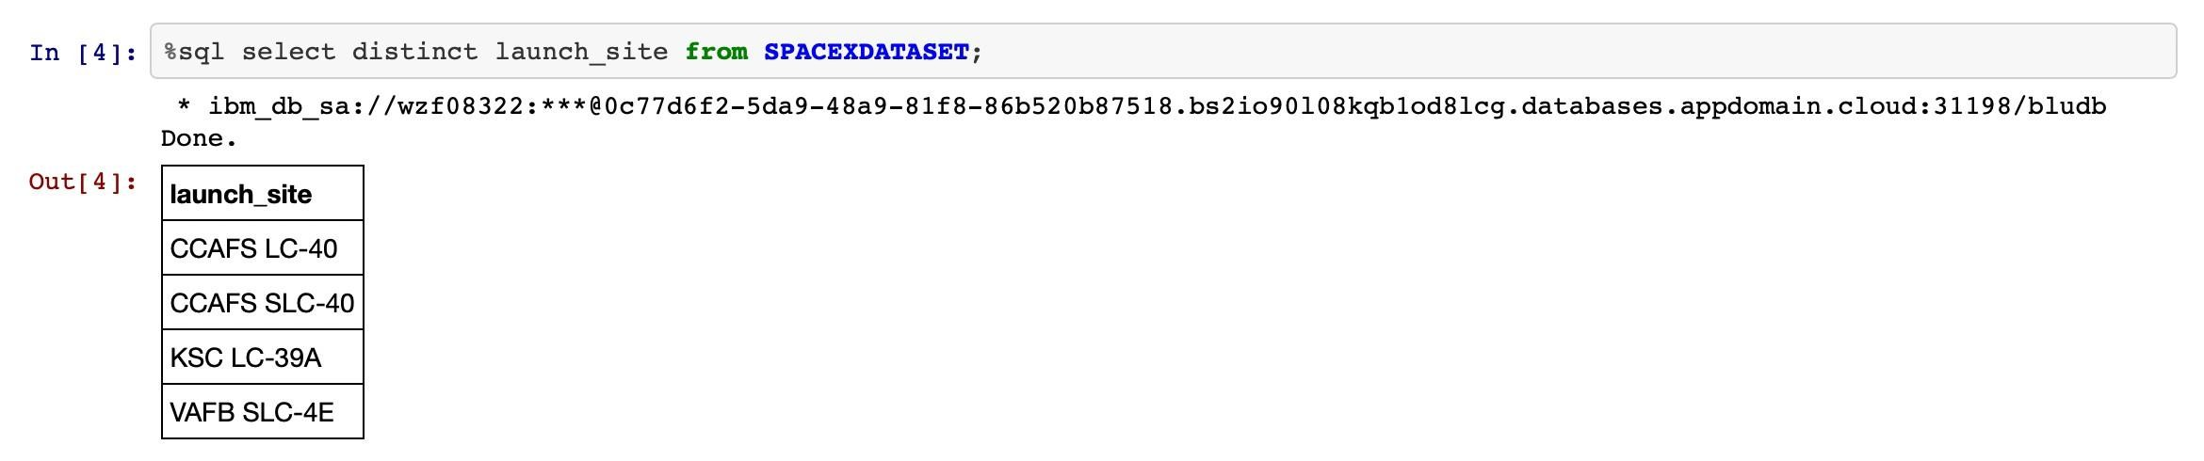
All launch site names
Showing the unique launch site names involved in the space mission.

Slide 26
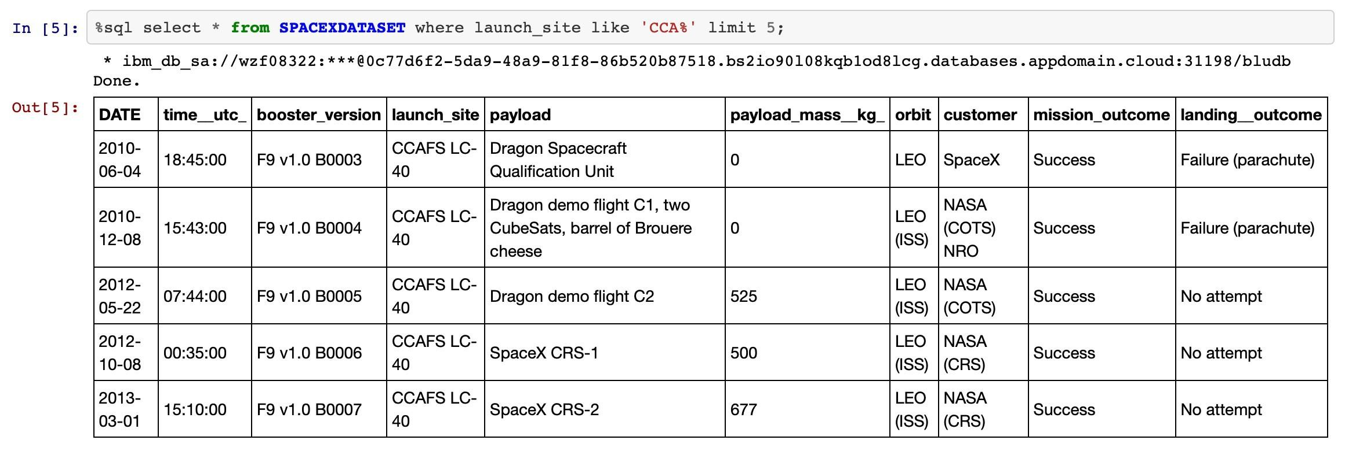
Launch site names begin with “CCA”
This statement is requesting to display five records where the launch sites start with the string 'CCA'. It's likely referring to a dataset or database where launch sites are listed, and the query is filtering for those that match the specified criteria.
Retrieve and display five records from the dataset/database where the launch sites begin with the string 'CCA'.

Slide 27
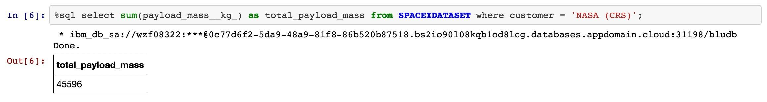
Total payload mass
Explanation:
This explanation requests the total payload mass carried by boosters launched by NASA under the Commercial Resupply Services (CRS) program.
Show the cumulative payload mass carried by boosters launched by NASA as part of the Commercial Resupply Services (CRS) program.

Slide 28
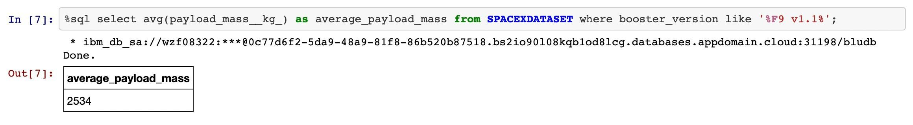
Average payload mass by F9 v1.1
Explanation:
Displaying average payload mass carried by booster version F9 v1.1.
1. Displaying: This indicates that we want to present or show some information.
2. Average payload mass: This refers to the mean value of the payload mass, which is the total mass of the cargo or equipment carried by the booster.
3. Carried by booster version F9 v1.1: This specifies the particular type or version of the booster for which we want to analyze the average payload mass. In this case, it's the booster version labeled F9 v1.1.
.

Slide 29
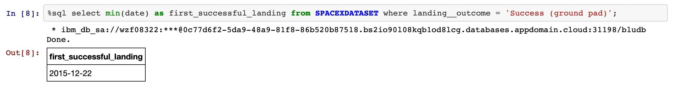
First successful ground landing date
Explanation:
Listing the date when the first successful landing outcome in ground pad was achieved.
Listing: This indicates that we want to compile or provide a list of information.
Date: Refers to the specific point in time when the event occurred.
First successful landing outcome: This specifies the nature of the event we are interested in, which is the successful landing of a rocket on a ground pad.
In ground pad: Specifies the location where the successful landing occurred, in this case, on a ground pad.

Slide 30
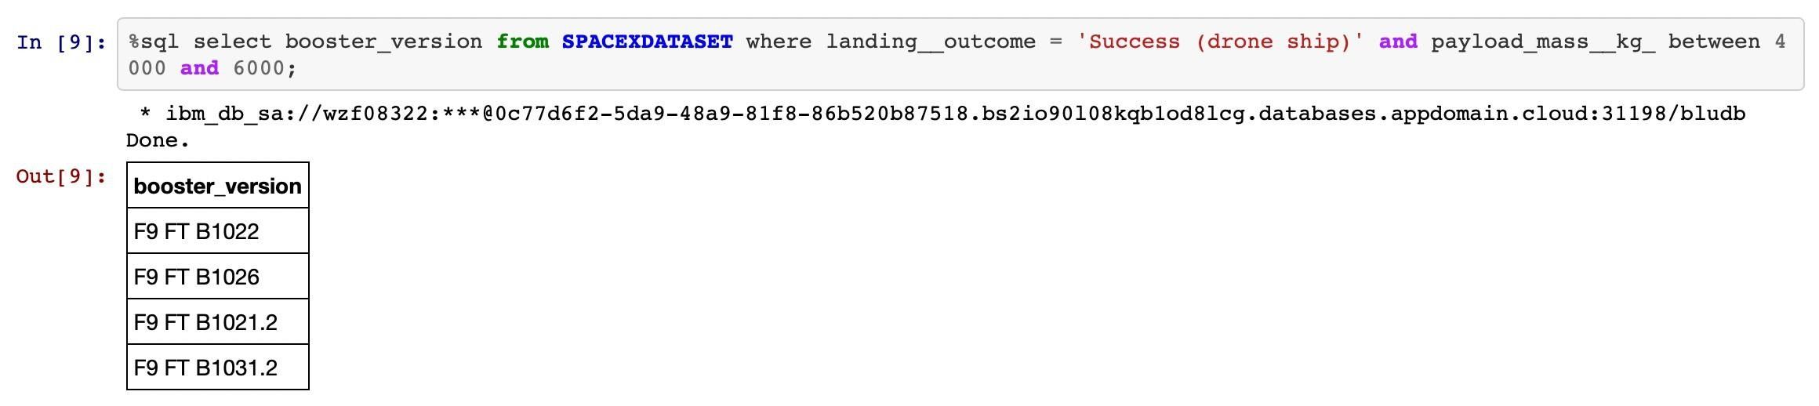
Successful drone ship landing with payload between 4000 and 6000
Explanation:
The task involves identifying and listing the names of booster rockets that achieved successful landings on a drone ship and had a payload mass greater than 4000 kg but less than 6000 kg. This requires examining data related to booster launches, specifically focusing on successful landings on drone ships and the corresponding payload masses. By filtering the data based on these criteria, we can isolate the booster instances that meet the specified conditions. The resulting list will provide insights into the performance of booster rockets in terms of successful landings on drone ships within a specific payload mass range, contributing to our understanding of the capabilities and effectiveness of these space mission components.

Slide 31
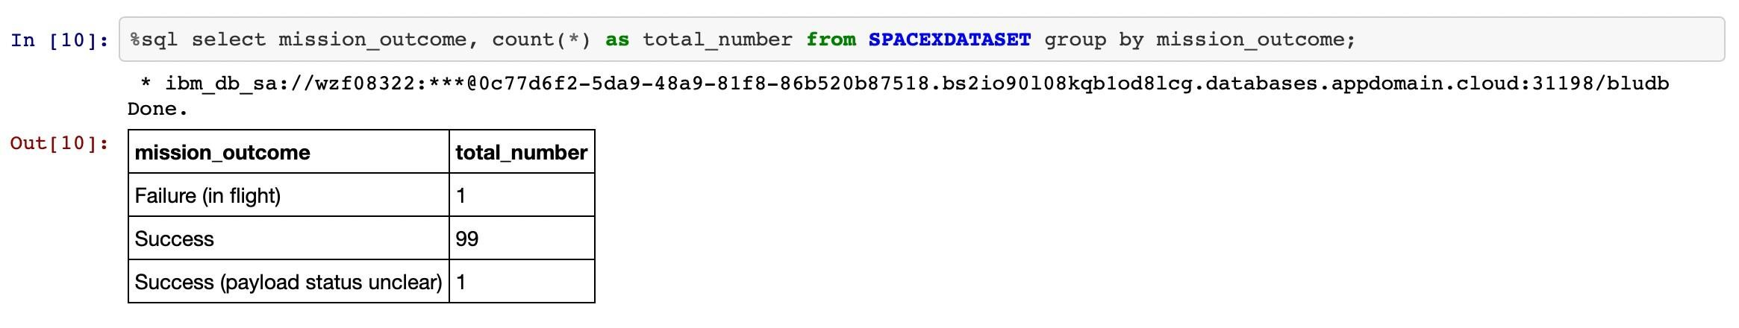
Total number of successful and failure mission outcomes
Explanation:
The task involves tallying successful and failed space mission outcomes from a dataset. By aggregating the data, the total counts of successful and failed missions are determined, providing insights into overall mission performance. This analysis aids in evaluating space exploration success and identifying areas for improvement.

Slide 32
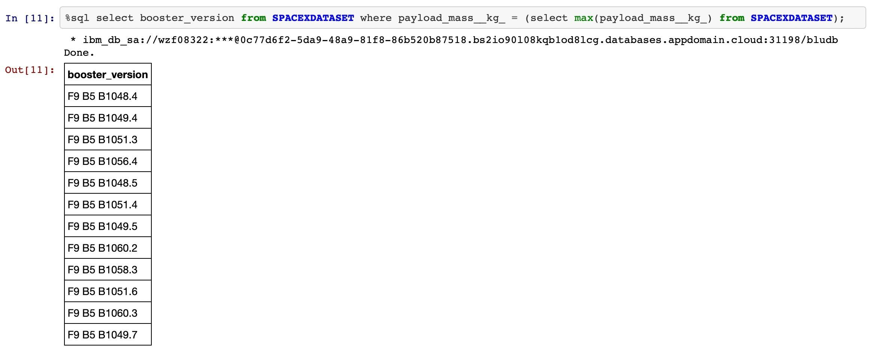
Boosters carried maximum payload
Explanation:
The task involves identifying booster versions that have carried the highest payload mass from a dataset. By analyzing the data, the names of booster versions with the maximum payload mass are listed. This information provides insights into the capacity and effectiveness of different booster versions in handling heavy payloads.

Slide 33
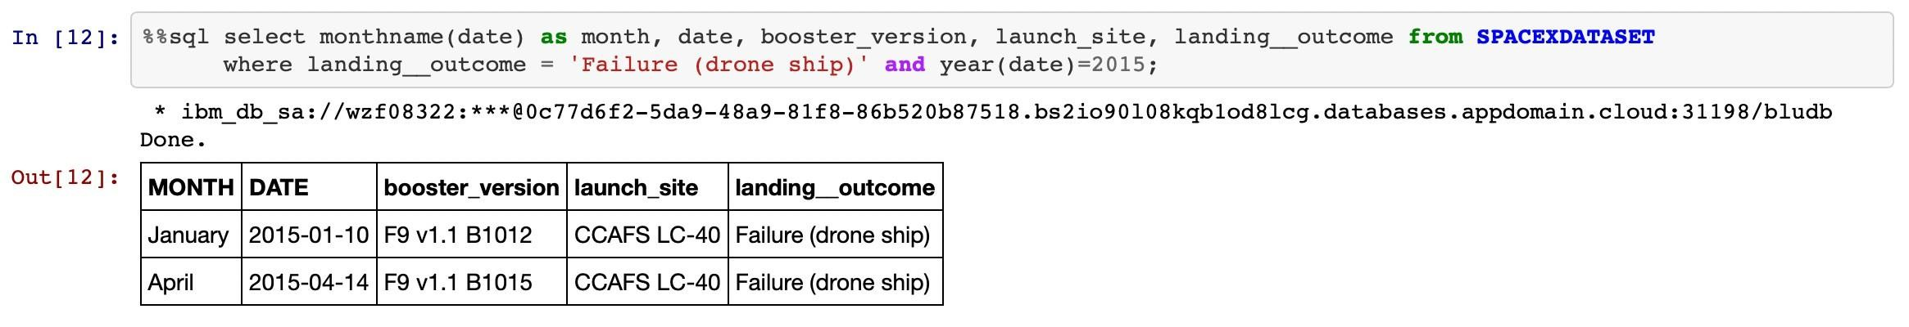
2015 Launch records
Explanation:
The task involves identifying failed landing outcomes in drone ships, along with their corresponding booster versions and launch site names, specifically for the months within the year 2015. By analyzing the dataset, this information provides insights into the performance of booster versions and the effectiveness of landing operations during that period.

Slide 34
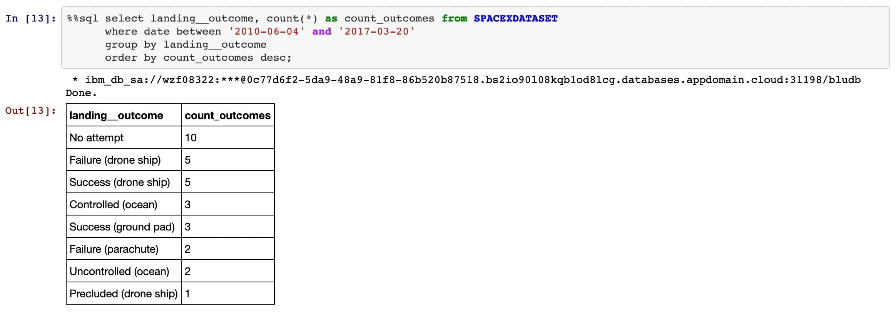
Rank success count between 2010.06.04 and 2017.03.20
Explanation:
The task aims to rank the count of landing outcomes, including Failure (drone ship) or Success (ground pad), between the dates June 4, 2010, and March 20, 2017, in descending order. This analysis provides insight into the success rates of landing attempts within the specified timeframe.

Slide 35
Interactive Map with Folium

Slide 36
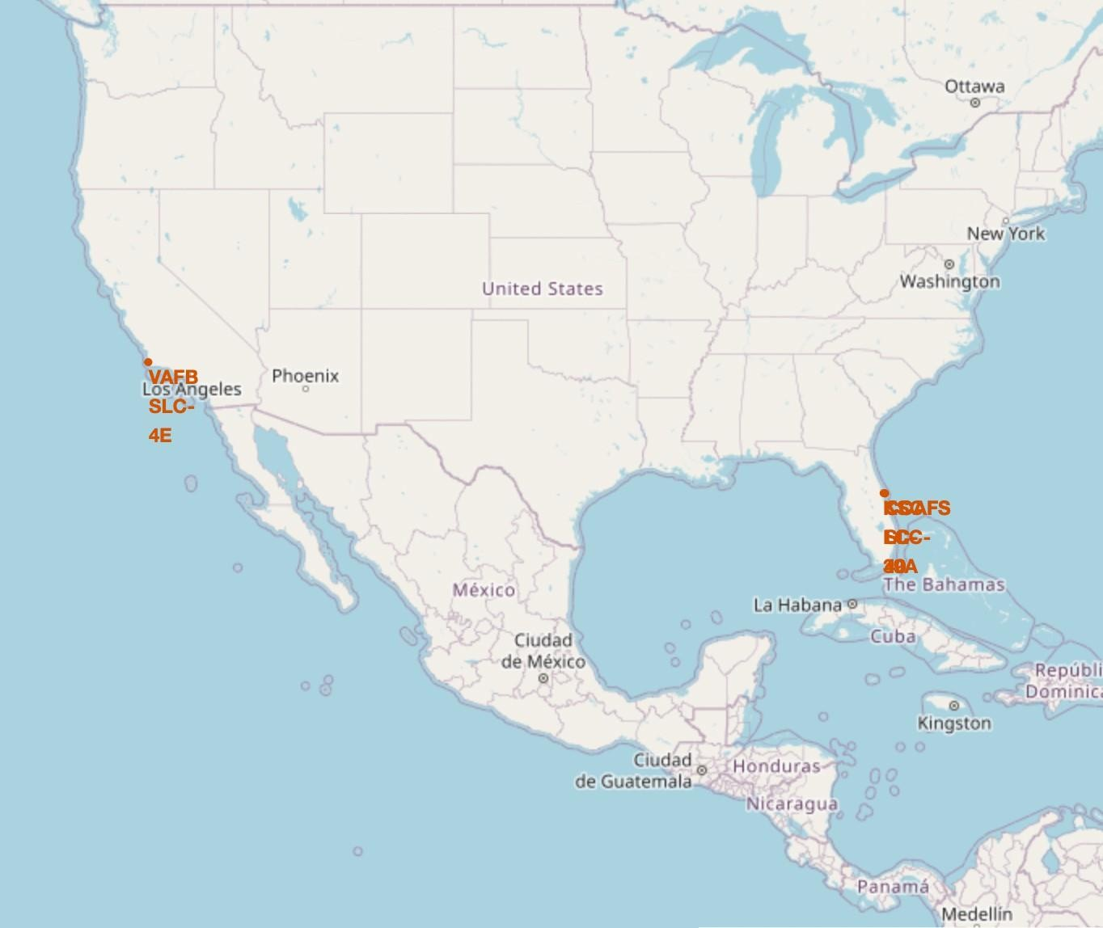
All launch sites’ location markers on global map
Explanation:
Most launch sites are strategically located near the Equator due to the higher rotational speed of the Earth at this latitude, facilitating spacecraft launches. Launching from the Equator allows the spacecraft to inherit the Earth's rotational velocity, aiding in achieving orbit. Additionally, launching rockets over the ocean minimizes the risk of debris endangering populated areas.

Slide 37
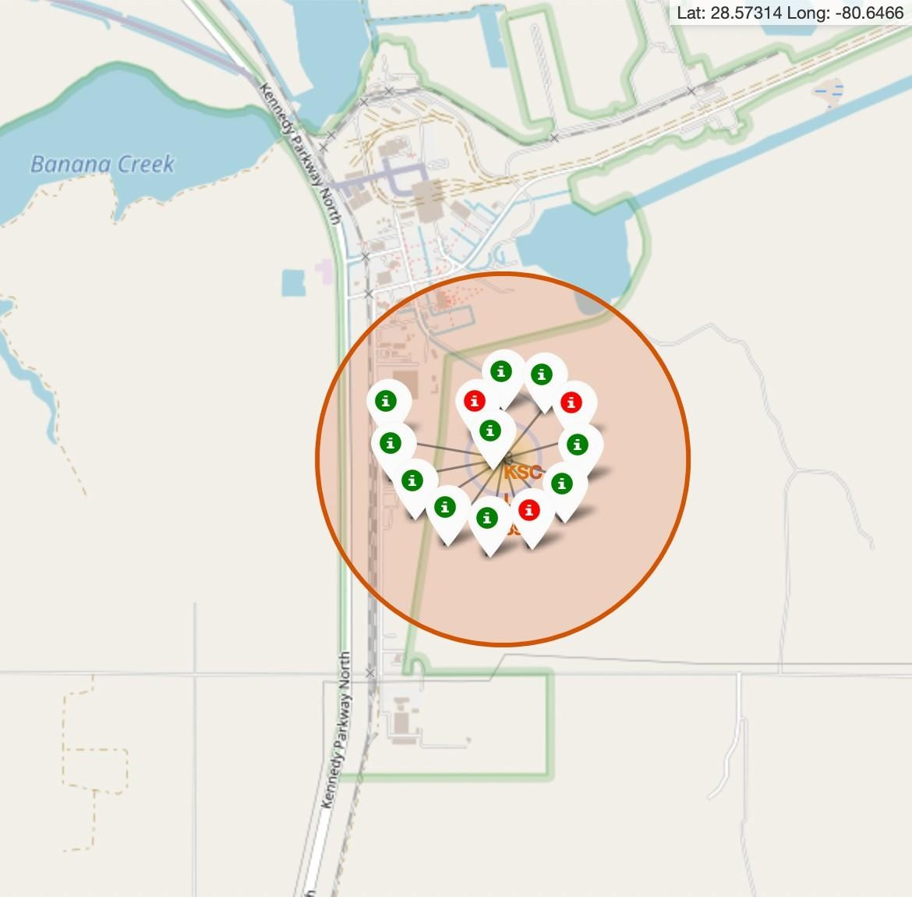
Colour – labeled launch records on the map
Explanation:
The color-labeled markers serve to distinguish between successful (green) and failed (red) launches, aiding in identifying launch sites with notably high success rates. KSC LC-39A stands out for its exceptionally high success rate, indicated by the predominance of green markers associated with this launch site.

Slide 38
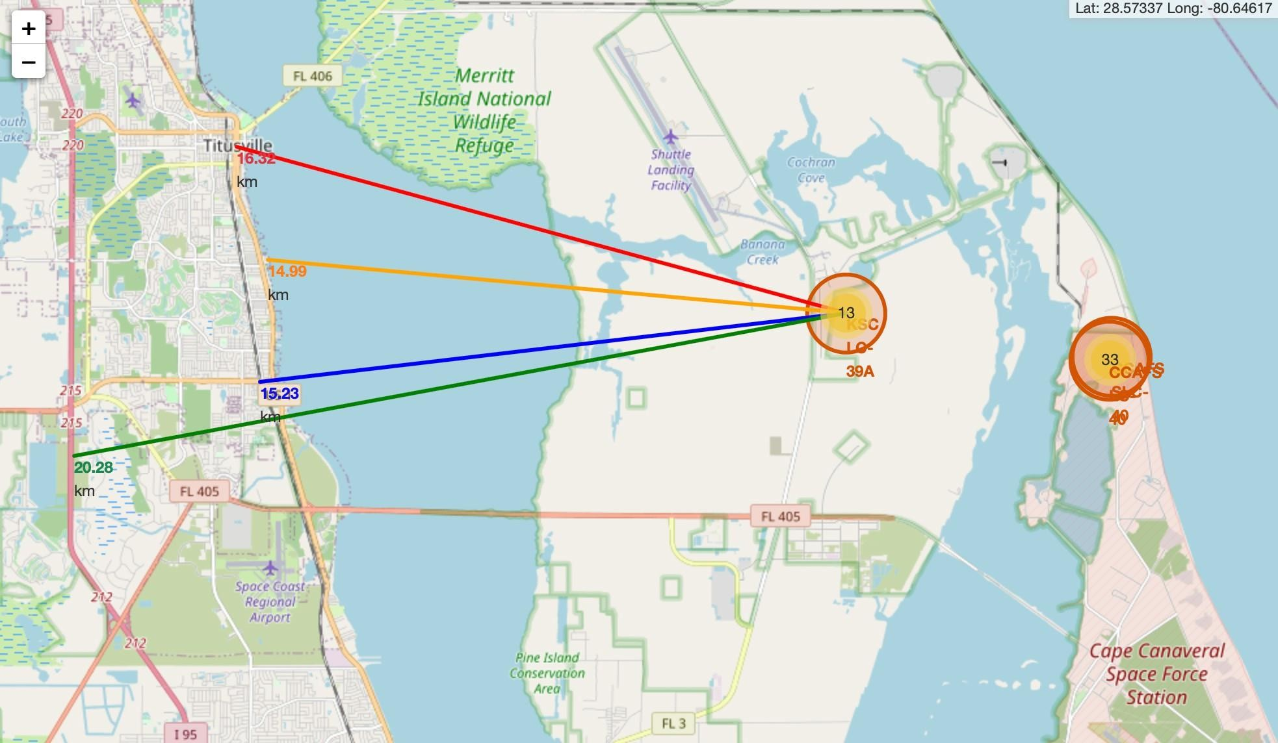
Distance from the launch site KSC LC-39A to its proximities
The analysis of launch site KSC LC-39A reveals its proximity to various infrastructural and geographical features:
Railway: Approximately 15.23 km away
Highway: Roughly 20.28 km away
Coastline: About 14.99 km away
Additionally, it is relatively close to the nearest city, Titusville, at a distance of approximately 16.32 km. Considering the potential danger of failed rockets, which can cover such distances in seconds, this proximity to populated areas raises safety concerns.

Slide 39
Build a Dashboard with Plotly Dash

Slide 40
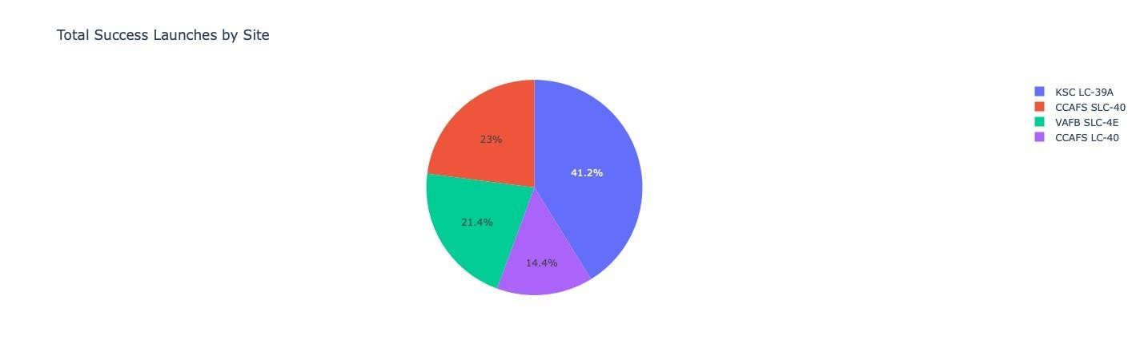
Launch success count for all sites
Explanation:
The chart distinctly illustrates that among all the launch sites, KSC LC-39A has the highest number of successful launches.

Slide 41
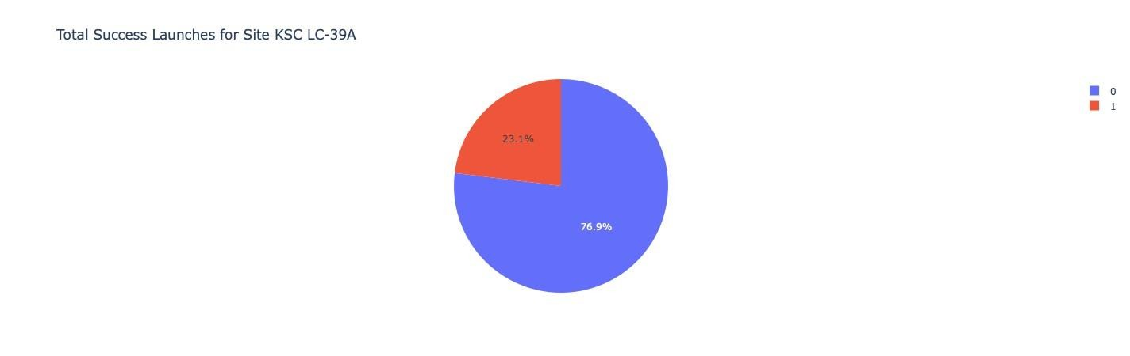
Launch site with highest launch success ratio
Explanation:
KSC LC-39A exhibits the highest launch success rate, standing at 76.9%. It has achieved 10 successful landings, with only 3 failed attempts. This site demonstrates superior reliability and effectiveness in launching missions, making it a preferred choice for space missions.

Slide 42
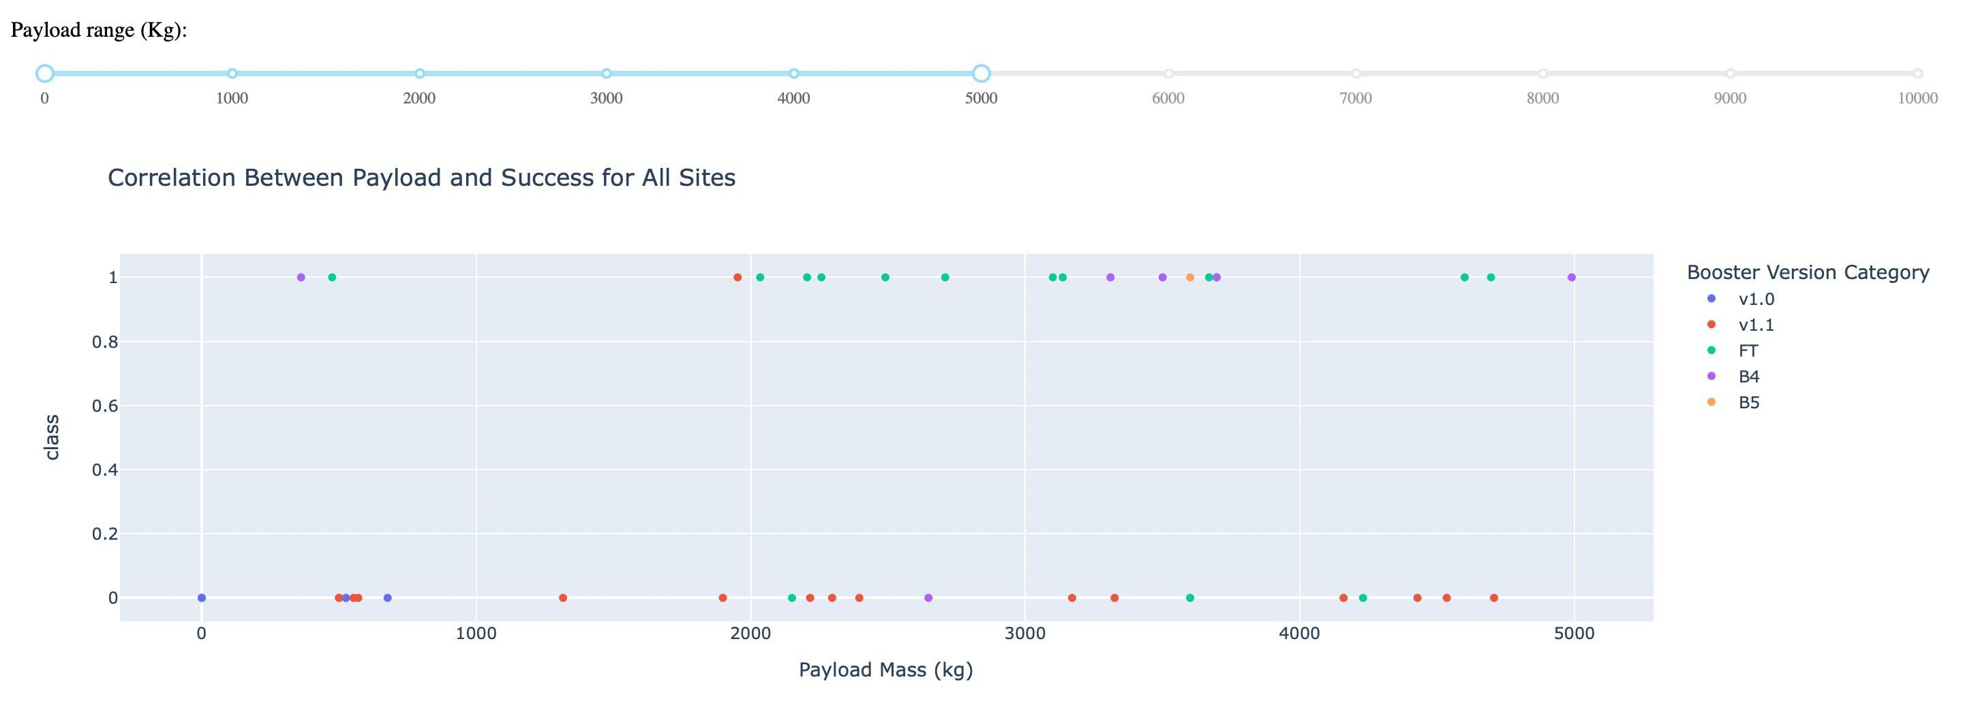
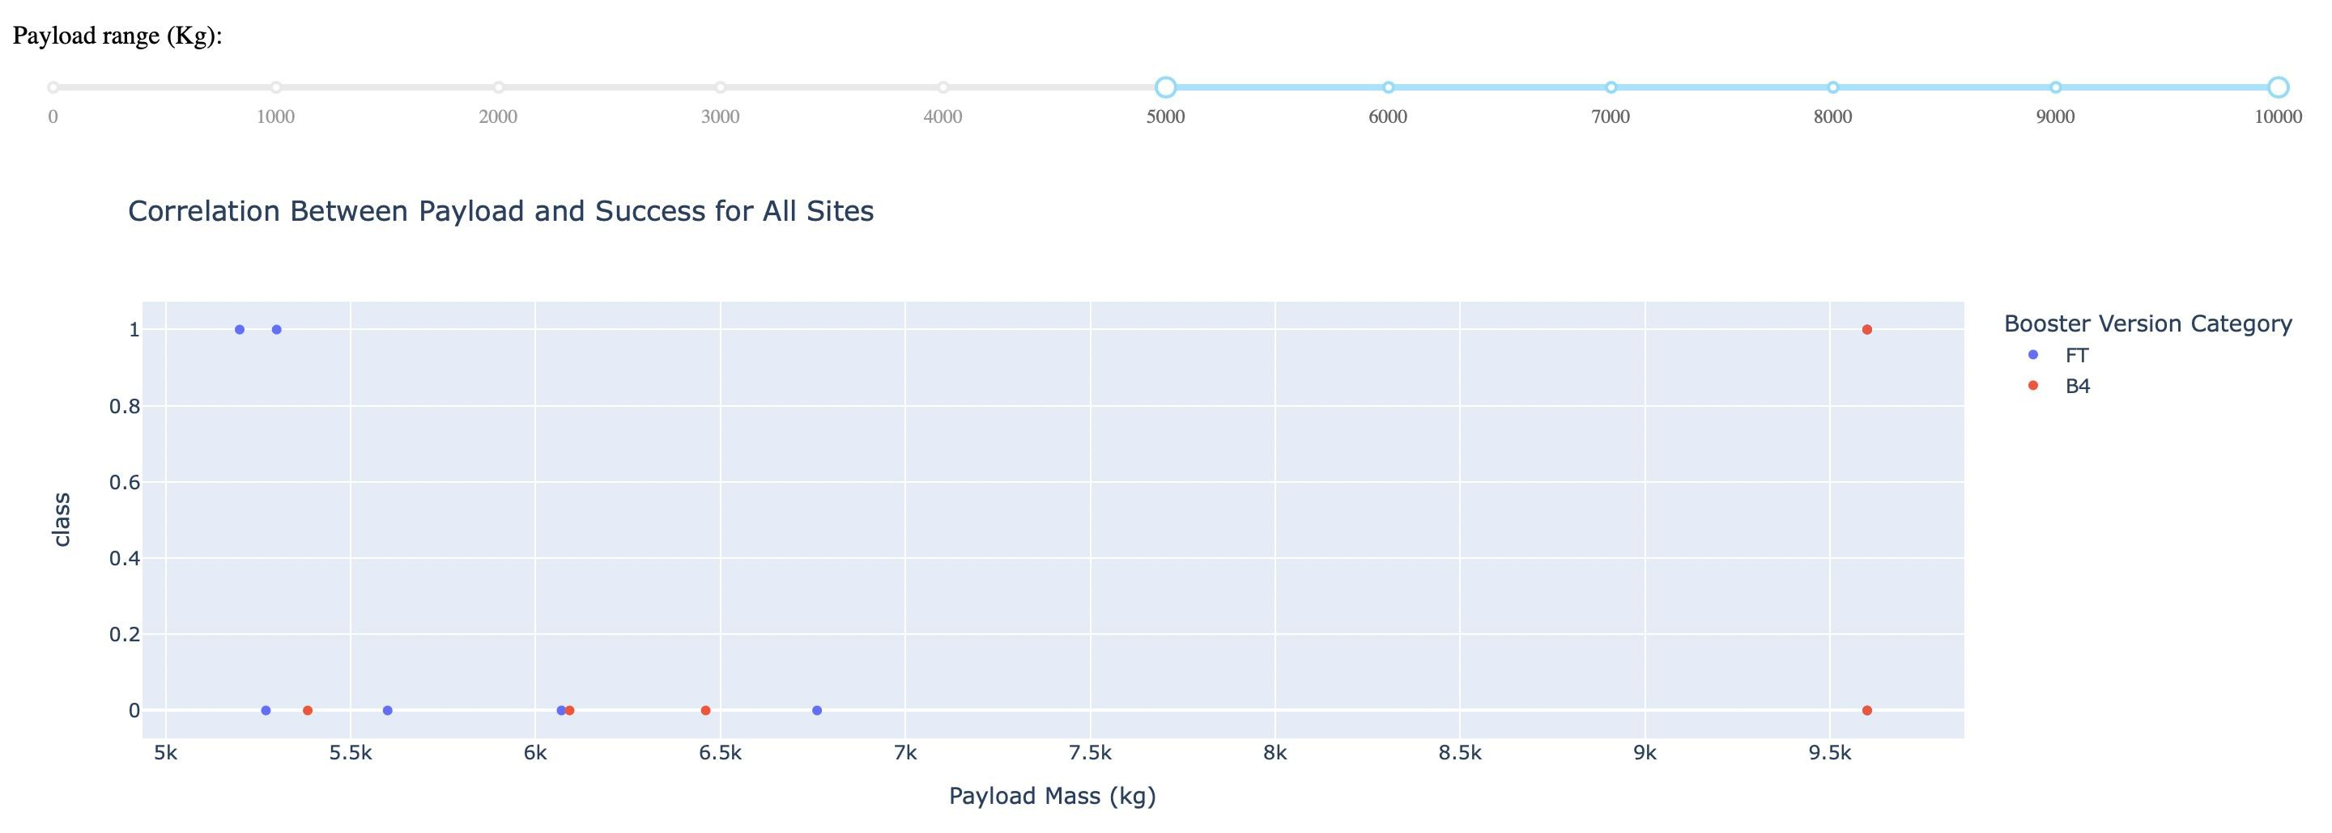
Payload Mass vs. Launch Outcomes for all sites
Explanation:
The visual representation indicates that payloads ranging from 2000 to 5500 kg exhibit the highest success rate in launches. This range demonstrates optimal performance, suggesting that payloads within this mass range are well-suited for successful missions, possibly due to optimal engineering and operational conditions.

Slide 43
Predictive analysis (Classification)

Slide 44
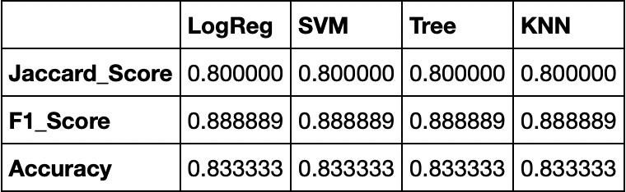
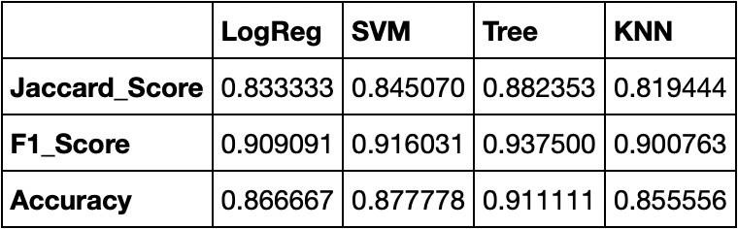
Classification Accuracy
Scores & Accuracy of the Test Set
Explanation:
The analysis of the Test Set scores doesn't provide conclusive evidence regarding the best-performing method. The consistency in scores could be attributed to the small sample size (18 samples).
Thus, we evaluated all methods using the entire dataset. The overall dataset scores reveal that the Decision Tree Model outperforms others, boasting higher scores and accuracy.
Scores & Accuracy of the Entire Data Set

Slide 45
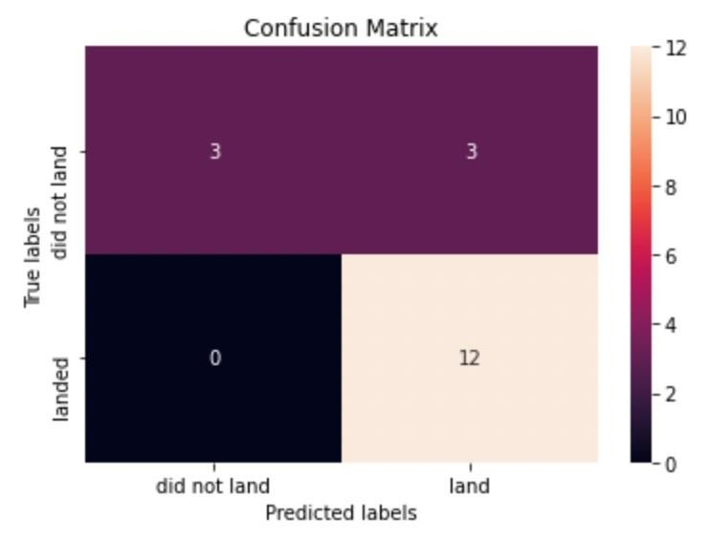
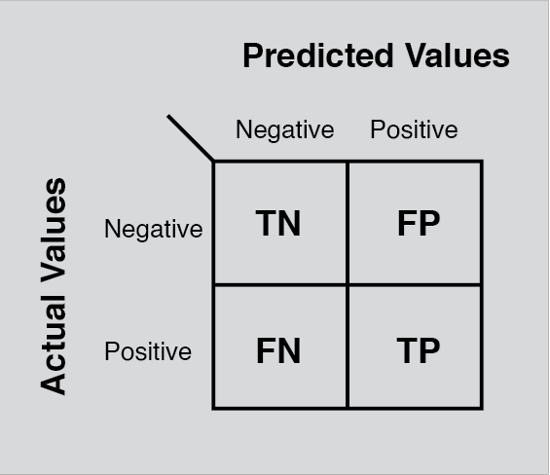
Confusion Matrix
Explanation:
Upon reviewing the confusion matrix, it's evident that logistic regression effectively distinguishes between various classes. However, a notable issue arises with false positives, indicating instances where the model incorrectly predicts a positive outcome.

Slide 46

Conclusion
The Decision Tree Model proves to be the most effective algorithm for this dataset.
Launches with lower payload masses exhibit better outcomes compared to those with larger payloads.
Additionally, most launch sites are near the Equator and coastline. Success rates have generally increased over time, with KSC LC-39A boasting the highest success rate among all sites.
Notably, orbits ES-L1, GEO, HEO, and SSO have achieved a 100% success rate.

Slide 47

Appendix
Special Thanks :
Instructors Coursera
IBM

